Slide 1
Responses to Literature 6ELAB

Slide 2
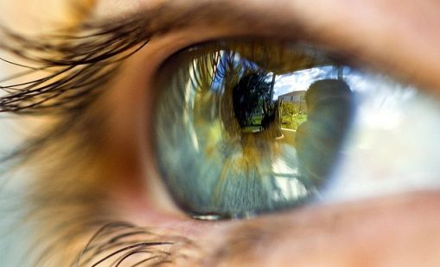
Responses to Literature …
For this response, think of a specific sight associated with your book. Again, this could be something a character physically sees, or would see, in their environment. Or perhaps it’s something they wish they could see.
A – What’s the sight in your book?
C – Provide some more details about the object or person being seen.
E – Explain the significance of the sight for the characters or story.

Slide 3
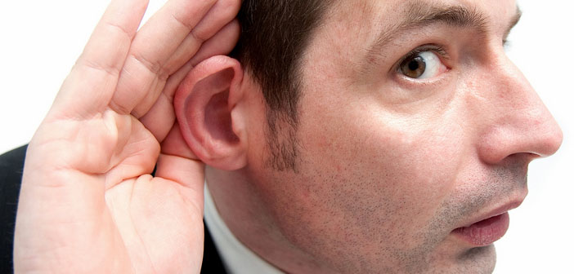
Responses to Literature …
For this response, think of a specific sound associated with your book. Again, this could be something a character physically hears, or would hear, in their environment. Or perhaps it’s something they wish they could hear.
A – What’s the sound in your book?
C – Provide some more details about the object or person being heard.
E – Explain the significance of the sound for the characters or story.

Slide 4
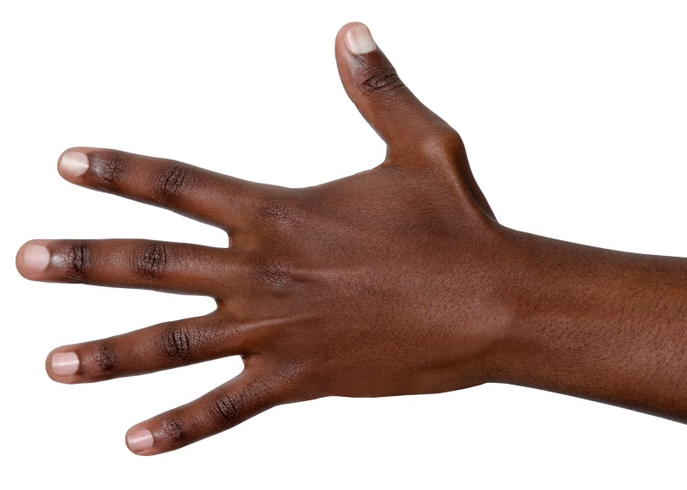
Responses to Literature …
For this response, think of a specific sensation of touch associated with your book. This could be something a character physically feels, or would feel, in their environment. Or perhaps it’s something they wish they could touch.
A – What’s the touch in your book?
C – Provide some more details about the object or person being touched.
E – Explain the significance of the touch for the characters or story.

Slide 5
Responses to Literature …
For this response, think of a specific smell associated with your book. Again, this could be something a character physically smells, or would smell, in their environment. Or perhaps it’s something they wish they could smell.
A – What’s the smell in your book?
C – Provide some more details about the object or person being smelled.
E – Explain the significance of the smell for the characters or story.

Slide 6
Responses to Literature …
For this response, think of a specific taste associated with your book. Again, this could be something a character physically tastes, or would taste, in their environment. Or perhaps it’s something they wish they could taste.
A – What’s the taste in your book?
C – Provide some more details about the thing being tasted.
E – Explain the significance of the taste for the characters or story.

Slide 7
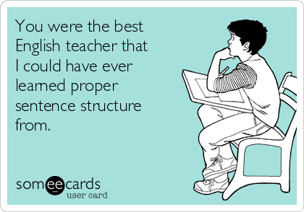
Responses to Literature …
For our writing responses today, I want you to quickly scan the pages you just read. Find what you believe to be the single best sentence. It could be short, long, simple or not. It could be description or dialogue. Pick something you felt was written well.
A – First, what’s happening in the story where the sentence takes place?
C – Then, write the sentence (or part) itself.
E – Finally, explain why you believe that sentence was the best one.

Slide 8
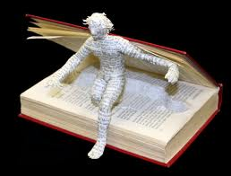
Responses to Literature …
If you could be a character in the book you’re reading, would you? Why or why not?
A – First, identify the character. Which part of the book would you, or would you not, want to be in?
C - Give an example of how you would affect the characters or plot.
E - Finally, explain why that part of the story does or does not appeal to you.

Slide 9
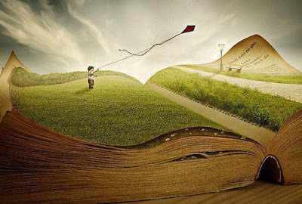
Responses to Literature …
In the pages you just read, find the single most interesting sentence (or part of one if it’s long). Use the guide below to complete your response.
A - What’s happening in the story where the sentence is found?
C - Write the sentence (or part) you found interesting.
E - Explain why you believe this sentence is the best one. Does it impact the story significantly? Does it contain figurative language? Is the vocabulary unique?

Slide 10
Responses to Literature …
Do you see any similarities between the book you’re currently reading and one you’ve read before?
A – What’s the similarity?
C - Provide more specific details about how they are similar.
E - Finally, explain how your example demonstrates this similarity.

Slide 11
Responses to Literature …
In a novel, the characters always have to want something (or someone) in order to create drama. This is what helps drive plot and makes a story compelling.
A – First, identify a character: What does that character want in your book?
C – Give an example from the book of the character actively wanting this thing (or person).
E – Finally, explain how wanting this thing affects the character throughout the book.

Slide 12
Responses to Literature …
It’s more or less easy to determine the point of view taken by an author. However, it’s not always easy to figure out why.
A – What point of view did the author choose to tell the story?
C - Next, provide an example from your book that demonstrates that point of view in action.
E - Finally, explain why you believe the author chose that point of view based on the evidence you mentioned.

Slide 13
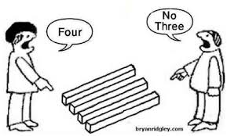
Responses to Literature …
Authors choose to write novels from one point of view or another for many reasons. What if the book you’re reading was told from a different point of view?
A - What is the narrator’s point of view in your book?
C - Next, provide evidence from the book that shows that point of view in action.
E - Finally, describe how that piece of evidence would change if the point of view changed. Specify the POV!

Slide 14
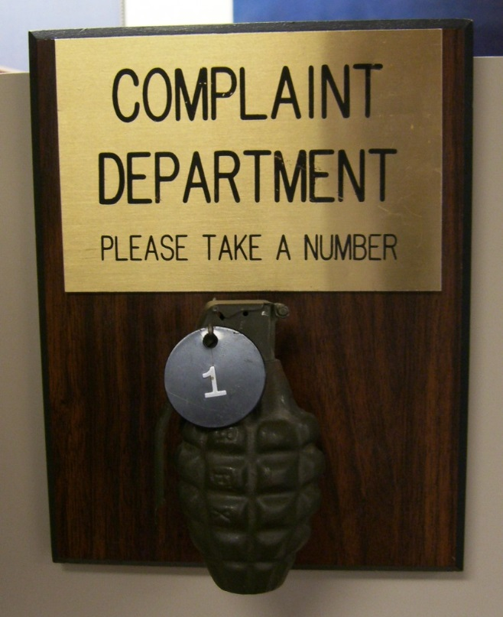
Responses to Literature …
In this response, you will file an official complaint against one of the characters in the book you’re reading. Use the format below to guide your response.
A – What’s one character’s main flaw?
C - Then, provide one or two specific examples from the text concerning how this flaw led to a poor choice.
E - Finally, explain how the character might correct this behavior.

Slide 15
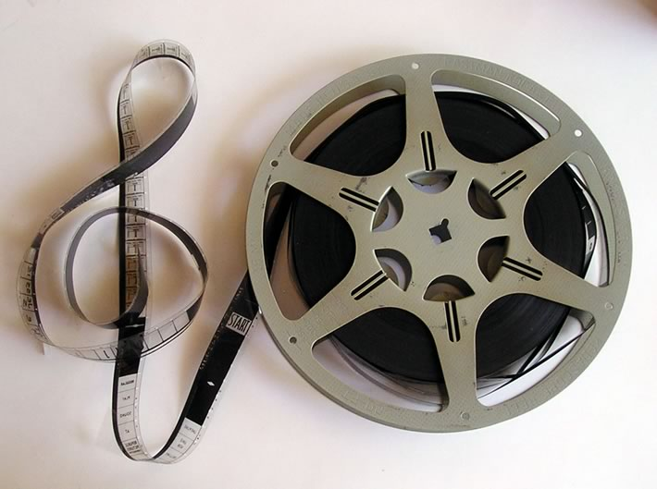
Responses to Literature …
If your book were adapted into a movie, what type of music do you think would go with it?
A - First, what song do you think would go well with your book?
C - Next, describe a scene from your book that would go along well with the song.
E - Finally, explain how the tone of the song would enhance the meaning of the scene.

Slide 16
Responses to Literature …
These days it seems like most movies and T.V. shows come from books in one way or another. In fact, T.V. series are becoming much more respectable now than they used to be.
A - Would your book make a better movie or a T.V. show?
C – Provide evidence from your book to prove your point.
E – Explain how that evidence supports your choice.

Slide 17
Responses to Literature …
Most people have a strong preference for either physical copies of books or digital versions like e-books. Which do you like better?
A - First, what is your preferred medium(physical or digital)?
C - Next, give an example from your experiences reading that helps explain why you have this preference.
E - Finally, elaborate on the benefits of your preferred medium.

Slide 18
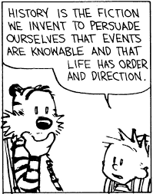
Responses to Literature …
For our writing responses today, I want to ask you a simple question: How believable is the story you’re reading? Obviously, if you’re reading a fantasy or sci-fi novel, then you’ll likely have elements that wouldn’t actually occur in the real world. However, the characters may still react in realistic ways to events or say things that are tied to real human emotions.
A – Is your book believable?
C – Provide an example of an element from the storyline, characters, or setting that is believable or not.
E – Explain why that element of your book is or isn’t believable.

Slide 19
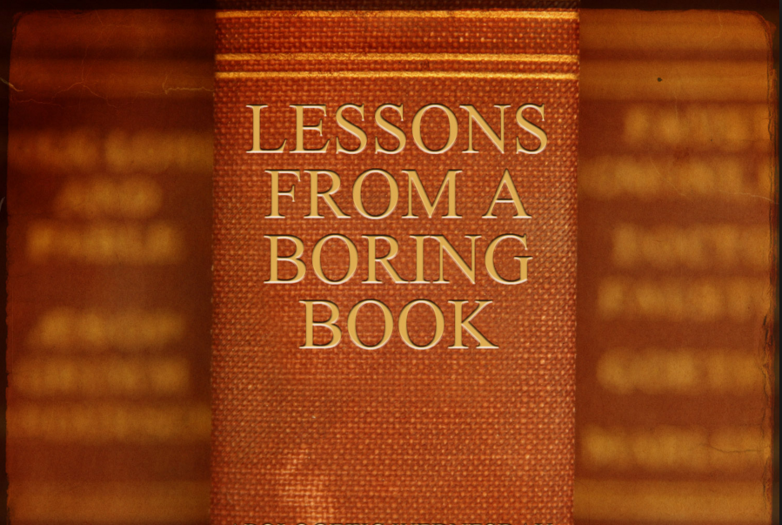
Responses to Literature …
Consider the many pages and pages from books you’ve read in your life. Some of that time you probably wish you could have back, but there are plenty of other moments besides that are well-spent in the pages of a memorable story.
A – For you, how good does a book have to be to keep you reading?
C – Provide an example of book you decided either was or wasn’t worth reading.
E – Explain why you think this.

Slide 20
Responses to Literature …
Now that you’ve been writing responses to your reading for about six weeks, you’ve probably learned a thing or two about what makes a fulfilling reading experience, as well as a few traits of a productive reader.
A – What’s one trait a good reader must have?
C – Provide an example from your own reading experience.
E – Explain how this trait supports a solid reading habit.

Slide 21
Responses to Literature …
In your years at school, you’ve had to read plenty of books. Hopefully you’ve been challenged by some and found a handful that you’ve truly enjoyed. With all of that experience in mind, begin to think of traits that make up a good writer.
A – What’s one trait a good writer must have?
C – Provide an example from your own reading experience.
E – Explain how this trait helps create a book worth reading.

Slide 22
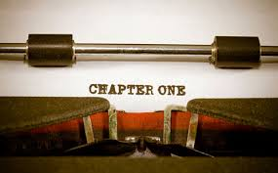
Responses to Literature …
Everyone has a story to tell. Depending on what that story is, an author might choose a specific genre, how long it would be, or even how they would want it to be published. Follow the ACE below for your response:
A – What’s your novel? (genre, topic, main character)
C – Provide an example as to why those choices fit your novel.
E – Explain why this novel appeals to you.

Slide 23
Responses to Literature …
Every good storyteller is able to establish a tone in their work. They may create this will elaborate descriptions, strong vocabulary, or interesting dialogue.
A – What is a dominant tone in your book?
C - Next, provide an example from your book that demonstrates that tone.
E - Finally, explain how the language in your evidence creates that tone.

Slide 24
Responses to Literature …
Sometimes it’s difficult to tell if the narrator of a novel is reliable or not. Do you think the narrator of your book is? How much can you trust them?
A - First, identify the narrator. Is this person reliable?
C - Next, provide evidence from the book that supports your decision.
E - Finally, describe how that piece of evidence proves their reliability or not.

Slide 25
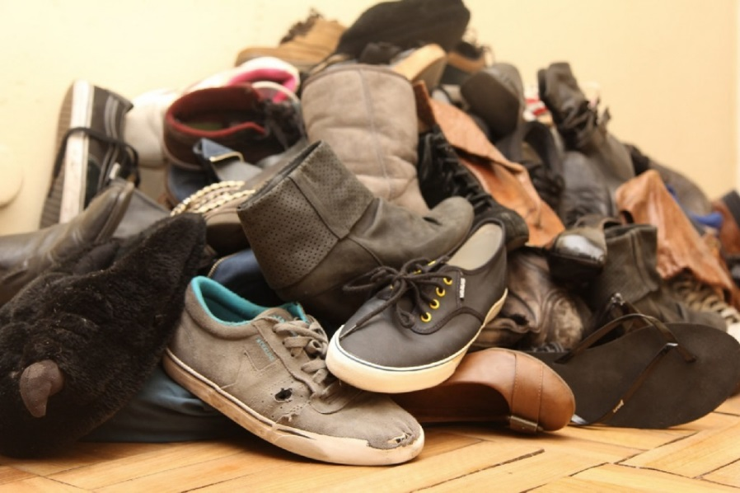
Responses to Literature …
Reading is an opportunity to see life in new ways. You can have the feeling of walking a mile in someone else’s shoes without having to move an inch. My question for you is this: If you could walk a mile in the shoes of the protagonist of
your book, how would you view your own life differently?
A – Answer the question.
C – Provide an example of a situation your protagonist faces
in your book.
E – How can you use this perspective to change your own life?

Slide 26
Responses to Literature …
I don’t for a minute believe someone when they say they don’t like to read. I always reply, “You haven’t found one you like to read yet.” Most of you probably do enjoy it and maybe even have a favorite book, series, or author you like to read.
A – What’s your favorite book, series, or author?
C – Provide some details about the book(s).
E – Explain why you think these books are worth reading.

Slide 27
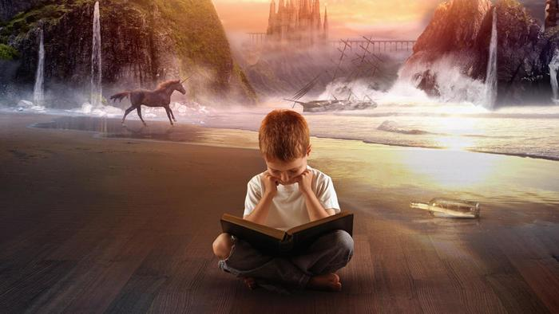
Responses to Literature …
The setting of a book is one of the most crucial elements in determining how a story unfolds and how characters behave in the story. Change the setting and you might change the book entirely.
A – What is one setting in your book?
C – Provide some details about the setting you chose.
E – Explain how you think the setting affects the characters or the story as a whole.

Slide 28
Responses to Literature …
A good book is nothing without the person reading it, and the reader’s mood affects the story as much as anything. As you read, closely examine how the author makes you feel with their storytelling, their language, and their tone.
A – What mood did your book make you feel while reading?
C – Provide an example of how the author used a specific part of the story to make you feel that way.
E – Explain how your mood affects your experience of the story.

Slide 29
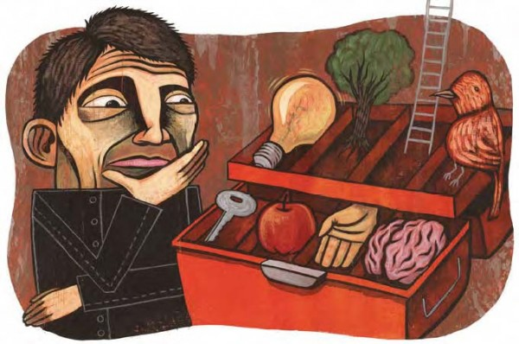
Responses to Literature …
Figurative language is an important tool in any writer’s tool box. A well-placed metaphor or simile can get to the bottom of what something means in a way sensory details can’t always manage. Every good writer uses it, so be on the lookout as you read.
A – What is a notable use of figurative language in your book?
C – Provide an example of the figurative language you found.
E – Explain why the author used the figurative language.

Slide 30
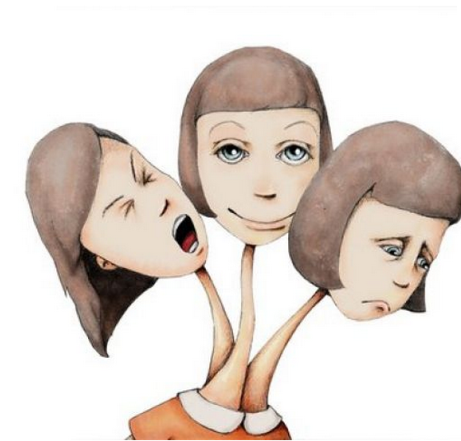
Responses to Literature …
When a thoughtful writer chooses a cast of characters, the writer will usually (the good ones, anyway) give them a healthy balance of personality traits to help push the story forward. Trying to analyze why a character behaves the way they do or why an author chose such a character is an important part of the reading process.
A – What is one significant personality trait of an important character in your book?
C – Provide an example of the character behaving that way.
E – Explain why you think the character behaves this way or why the author chose this type of main character.

Slide 31
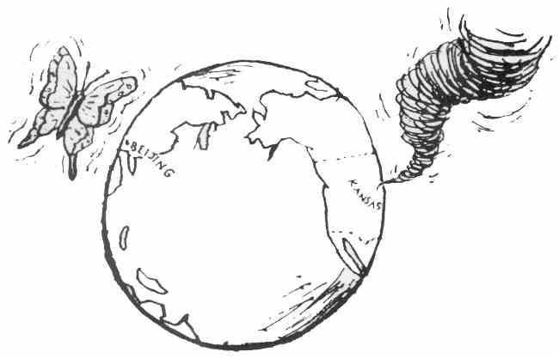
Responses to Literature …
In order for a story to hold a reader’s interest, each event has to tie in to other events in some intriguing way. As the events progress, the story and characters should change in a meaningful way. It’s up to you, the reader, to figure out why.
A – What is an important event that takes place in your book?
C – Describe how the event occurs in the story.
E – Explain how the event changes the characters or the story in a meaningful way.

Slide 32
Responses to Literature …
It’s no accident that the characters in your book are what they are. Any author worth reading will have a good reason for their choice to decide the gender of their characters. It’s your job as a reader to decide why.
A – What is the gender of an important character in your book?
C – Describe how the character normally behaves in the story.
E – Explain how the character would behave differently (or how other characters would react to them) if they had been a different gender all along.

Slide 33
Responses to Literature …
Age matters. If a character is young, they will respond differently to the circumstances in the book than if they had been older, and vice-versa. We all experience life based on how much of it we’ve experienced prior, and characters in a story are no different.
A – About what age is an important character in your book?
C – Describe how the character normally behaves in the story that might show them acting their age.
E – Explain how the character would behave differently (or how other characters would react to them) if they had been a drastically different age all along.

Slide 34
Responses to Literature …
Understanding how characters in a story relate to themselves or one another based upon race is as key to analyzing a story as anything else. Although some authors may place more
focus on race than others, it is always an important aspect to consider when evaluating a character’s thoughts and actions.
A – What is the race of an important character in your book?
C – Describe how the character normally behaves in the story.
E – Explain how the character would behave differently (or how other characters would react to them) if they had been a different race all along. If not, why?

Slide 35
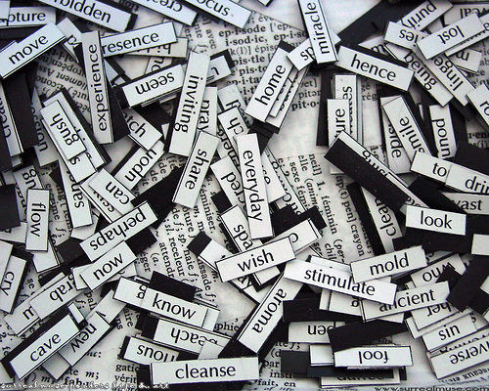
Responses to Literature …
All of the best stories and characters in literature have been carefully crafted by their authors. However, this doesn’t mean they’re perfect. Any story can be done better to reflect new ideas or reach a different audience.
A – What is one aspect of your book you think the author should have written differently?
C – Describe how the author originally wrote it.
E – Explain how you would write it differently and why.

Slide 36
Responses to Literature …
We’ve all heard this maxim: “Don’t judge a book by its cover.” The question begs to be asked then, Why have a book cover at all? The truth is, a cover does say quite a bit about the book inside.
A – Do you think the cover of your book adequately represents your book?
C – Describe the book cover in detail.
E – Explain why the cover does or does not do a decent job expressing the story of the book.

